Slide 1

Welcome back! Link to Attendance Form ↓

Slide 2
Pop Quiz: Containers
Which type(s) lets you insert at the back and front equally efficiently?
Which type(s) requires a comparison operator on the element type?
What type(s) can we use to get around this?
Which is usually faster: unordered_set or set? Why?

Slide 3
Pop Quiz: Containers (Answers)
Which type(s) lets you insert at the back and front equally efficiently?
✅ std::deque
Which type(s) requires a comparison operator on the element type?
✅ std::map, std::set
Which is usually faster: unordered_set or set? Why?
✅ std::unordered_set (Hashing + small load factor)!

Slide 5
Last Time: Containers
0
1
2
4
1
2
3
4
1
9
7
3
2
1
2
9
0
“Chris”
31
“CS106L”
42
1
2
“Nick”
51
“Chris”
31
“Nick”
51
3
“Sean”
35
“Keith”
14
“Sean”
35
4

Slide 6
for (const auto& elem : container)
std::map
std::vector
std::set
std::deque
How does this work?

Slide 7
For-each loops… huh?
std::vector<int> v { 1, 2, 3, 4 };
for (const auto& elem : v) {
std::cout << elem << std::endl;
}
0
1
2
4
1
2
3
4

Slide 8
For-each loops… huh?
std::deque<int> d {
1, 9, 7, 3,
2, 1, 2, 9
};
for (const auto& elem : d) {
std::cout << elem << std::endl;
}
1
9
7
3
2
1
2
9

Slide 9
For-each loops… huh?
std::map<std::string, int> m {
{ "Chris", 31 }, { "CS106L", 42 },
{ "Keith", 14 }, { "Nick", 51 },
{ "Sean", 35 },
};
for (const auto& pair : m) {
std::cout << pair.first << " ";
std::cout << pair.second;
}
“CS106L”
42
“Chris”
31
“Nick”
51
“Keith”
14
“Sean”
35

Slide 10
For-each loops… huh?
std::unordered_map<string, int> m
{
{ "Chris", 31 }, { "Nick", 51 },
{ "Sean", 35 },
};
for (const auto& pair : m) {
std::cout << pair.first << " ";
std::cout << pair.second;
}
0
“Chris”
31
1
2
“Nick”
51
3
“Sean”
35
4

Slide 11
for (const auto& elem : container)
How does this work?

Slide 12
Lecture 6: Iterators
CS106L, Autumn 2024

Slide 13
The Standard Template Library (STL)
Containers
How do we store groups of things?
Iterators
How do we traverse containers?
Functors
How can we represent functions as objects?
Algorithms
How do we transform and modify containers in a generic way?

Slide 14
Today’s Agenda
Iterator Basics
What even is an iterator?
Iterator Types
Iterators are organized by their properties
Pointers and Memory
What is a pointer? What is memory?

Slide 16
Iterator Basics

Slide 17
Question: How do we iterate?
std::vector<int> v {1,2,3,4};
for (size_t i = 0; i < v.size(); i++) {
const auto& elem = v[i];
}
for (var-init; condition; increment) {
const auto& elem = /* grab element */;
}

Slide 18
Question: How do we iterate?
for (auto e : s) is not allowed ...for now
for (var-init; condition; increment) {
const auto& elem = /* grab element */;
}
std::set<int> s {1,2,3,4};
for (uhhh; ummm; what?) {
const auto& elem = /* haeelp 🥺🥺 */;
}

Slide 19
We need something to track where we are in a container… sort of like an index

Slide 20
Introducing iterators 😎😎

Slide 21
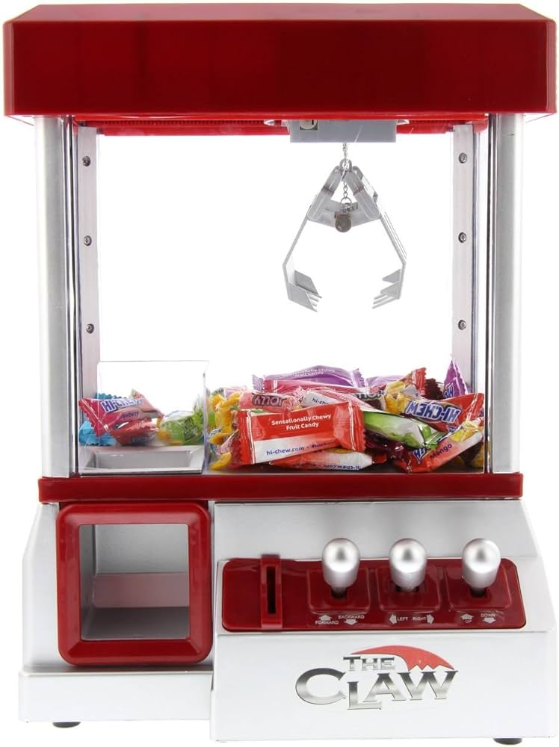
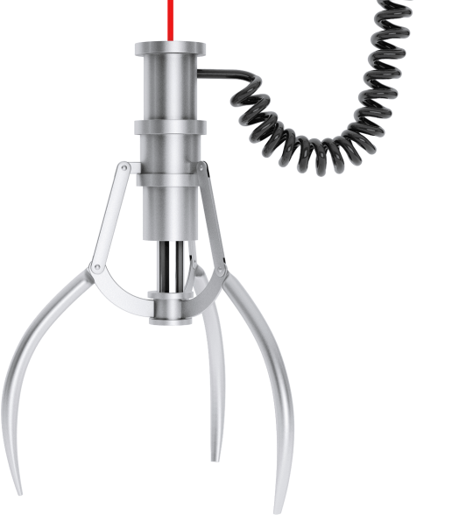
C++ iterators are like a “claw” in a claw machine
The claw can:
Grab a toy
Move forward
Check if we’re done
The machine can:
Tell us where to start
Tell us when to stop

Slide 22


C++ Iterators Example
++it;
++it;
++it;
++it;
auto elem = *it;
++it;
it == c.end()
++it;
auto it = c.begin();

Slide 23
Containers and iterators work together to allow iteration

Slide 24
Container Interface
container.begin()
Gets an iterator to
the first element
of the container
(assuming non-empty)
container.end()
Gets a past-the-end iterator
That is, an iterator to
one element after the
end of the container

Slide 25
end() never points to an element!
Instead, it points one past the end of the container
c.begin()
c.end()

Slide 26
end() never points to an element!
If c is empty, then begin() and end() are equal!
c.begin()
==
c.end()

Slide 27
Iterator Interface
// Copy construction
auto it = c.begin();
// Increment iterator forward
++it;
// Dereference iterator -- undefined if it == end()
auto elem = *it;
// Equality: are we in the same spot?
if (it == c.end()) ...

Slide 28
We have an answer now!
for (auto e : s) is not allowed ...for now
std::set<int> s {1,2,3,4};
for (var-init; condition; increment) {
const auto& elem = /* grab element */;
}
for ( ; ; ) {
const auto& elem = /* grab element */;
}

Slide 29
We have an answer now!
for (auto e : s) is not allowed ...for now
std::set<int> s {1,2,3,4};
for (var-init; condition; increment) {
const auto& elem = /* grab element */;
}
for (auto it = s.begin(); ; ) {
const auto& elem = /* grab element */;
}

Slide 30
We have an answer now!
for (auto e : s) is not allowed ...for now
std::set<int> s {1,2,3,4};
for (var-init; condition; increment) {
const auto& elem = /* grab element */;
}
for (auto it = s.begin(); it != s.end(); ) {
const auto& elem = /* grab element */;
}

Slide 31
We have an answer now!
for (auto e : s) is not allowed ...for now
std::set<int> s {1,2,3,4};
for (var-init; condition; increment) {
const auto& elem = /* grab element */;
}
for (auto it = s.begin(); it != s.end(); ++it) {
const auto& elem = /* grab element */;
}

Slide 32
We have an answer now!
for (auto e : s) is not allowed ...for now
std::set<int> s {1,2,3,4};
for (var-init; condition; increment) {
const auto& elem = /* grab element */;
}
for (auto it = s.begin(); it != s.end(); ++it) {
const auto& elem = *it;
}

Slide 33
When you write…
It’s actually this:
for (auto elem : s)
{
std::cout << elem;
}
auto b = s.begin();
auto e = s.end();
for (auto it = b; it != e; ++it) {
auto elem = *it;
std::cout << elem;
}

Slide 35
We have an answer now!
for (auto e : s) is not allowed ...for now
std::set<int> s {1,2,3,4};
for (var-init; condition; increment) {
const auto& elem = /* grab element */;
}
for (auto it = s.begin(); it != s.end(); ++it) {
const auto& elem = *it;
}

Slide 36

Guess we’re done here!

Slide 37
We have an answer now!
for (auto e : s) is not allowed ...for now
std::set<int> s {1,2,3,4};
for (var-init; condition; increment) {
const auto& elem = /* grab element */;
}
for (auto it = s.begin(); it != s.end(); ++it) {
const auto& elem = *it;
}
What type is this?

Slide 38
What are the types?
Using auto avoids spelling out long iterator types
std::map<int, int> m { {1, 2}, {3, 4}, {5, 6}};
auto it = m.begin();
auto elem = *it;
std::map<int, int> m { {1, 2}, {3, 4}, {5, 6}};
std::map<int, int>::iterator it = m.begin();
std::pair<int, int> elem = *it;
// {1, 2}

Slide 39
Remember: using makes a type alias
// Inside <map> header
template <typename K, typename V>
class std::map {
using iterator = /* some iterator type */;
};
// Outside <map> header (e.g. main.cpp)
std::map<int, int>::iterator it = m.begin();

Slide 40
Aside: Why do we use ++it instead of it++?

Slide 41
++it avoids making an unnecessary copy
// Prefix ++it
// Increments it and returns a reference to same object
Iterator& operator++(int);
// Postfix it++
// Increments it and returns a copy of the old value
Iterator operator++();

Slide 42
Does it actually make a difference?

Slide 43

Bjarne’s Thoughts
yup
“
++i is sometimes faster than, and is never slower than, i++. ... So if you’re writing i++ as a statement rather than as part of a larger expression, why not just write ++i instead? You never lose anything, and you sometimes gain something.
[source]

Slide 45
Your Turn
Trace this code with a partner to find out where each iterator points
std::map<int, int> m {
{1, 2}, {3, 4}, {5, 6}
};
auto a = m.begin();
++a;
auto b = a;
++a;
auto c = ++a;
m.begin()
m.end()
1
2
3
4
5
6
a
b
c

Slide 46
Announcements

Slide 47


Apply to Section Lead!
Section leading is one of the most rewarding things we’ve done at Stanford – it’s how we’re here!
PLEASE, ask us questions about it :)
App is due Thursday, October 17th or if you’re currently enrolled in CS106B, November 2nd
Apply here!

Slide 48
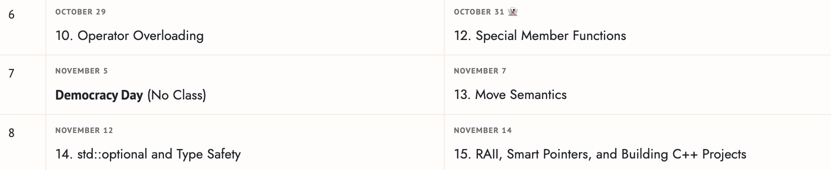
Change in Lecture Schedule
There will be no lecture on Democracy Day (all classes canceled)
We will have lecture on Thursday of Week 8 to accommodate

Slide 49
Assignment #1 & OH
Assignment 1 due tomorrow at midnight
Office hours
Friday 1-2:30pm Thornton 208 (Jacob)
Wednesday 3-4pm Zoom (Fabio)

Slide 51
Iterator Types

Slide 52
Not all iterators are made equal

Slide 53
All iterators provide these four operations
auto it = c.begin();
++it;
*it;
it == c.end()
But most provide even more
--it; // Move backwards
*it = elem; // Modify
it += n; // Rand. access
it1 < it2 // Is before?

Slide 54
Iterator types determine their functionality
Input
Output
Forward
Let’s unpack this!
Bidirectional
Random Access

Slide 55
Input Iterators
Input
Most basic kind of iterator
Allows us to read elements
auto elem = *it;
Vivid Venn Diagram of
Vexing Iterators

Slide 56

Input Iterators: operator->
If the element is a struct, we can access its members with ->
Bibble, v. “To eat and/or drink noisily”
struct Bibble {
int zarf;
};
std::vector<Bibble> v {...};
auto it = v.begin();
int m = (*it).zarf;
int m = it->zarf; // Exactly the same as prev!

Slide 57
Input Iterators
Input
Most basic kind of iterator
Allows us to read elements
auto elem = *it;
Output
Output Iterator
Allows us to write elements
*it = elem;
Vivid Venn Diagram of
Vexing Iterators

Slide 58
Forward Iterator
Input
Forward
An input iterator that allows us to make multiple passes
All STL container iterators fall here
Output
Multi-pass guarantee
it1 == it2
++it1 == ++it2
What kind of data structure might not want a multi-pass iterator?
Streams!!!
Vivid Venn Diagram of
Vexing Iterators

Slide 59
Bidirectional Iterators
Input
Forward
Allows us to move forwards and backwards
std:map, std::set
Bidirectional
Output
auto it = m.end();
// Get last element
--it;
auto& elem = *it;
Vivid Venn Diagram of
Vexing Iterators

Slide 60
Random Access Iterators
Input
Forward
Allows us to quickly skip forward and backward
std::vector, std::deque
Bidirectional
Random Access
Output
auto it2 = it + 5; // 5 ahead
auto it3 = it2 - 2; // 2 back
// Get 3rd element
auto& second = *(it + 2);
auto& second = it[2];
Vivid Venn Diagram of
Vexing Iterators

Slide 61
Be careful not to go out of bounds
std::vector<int> v { 1, 2, 3 };
auto it = v.begin();
it += 3;
int& elem = *it; // Undefined behaviour
0
1
2
1
2
3
it

Slide 63
STL Iterator Types
Input
Forward
map
set
Bidirectional
istream
Random Access
unordered_map
unordered_set
vector
deque
Output
ostream

Slide 64
Pointers and Memory

Slide 65
An iterator points to a container element
A pointer points to any object

Slide 66
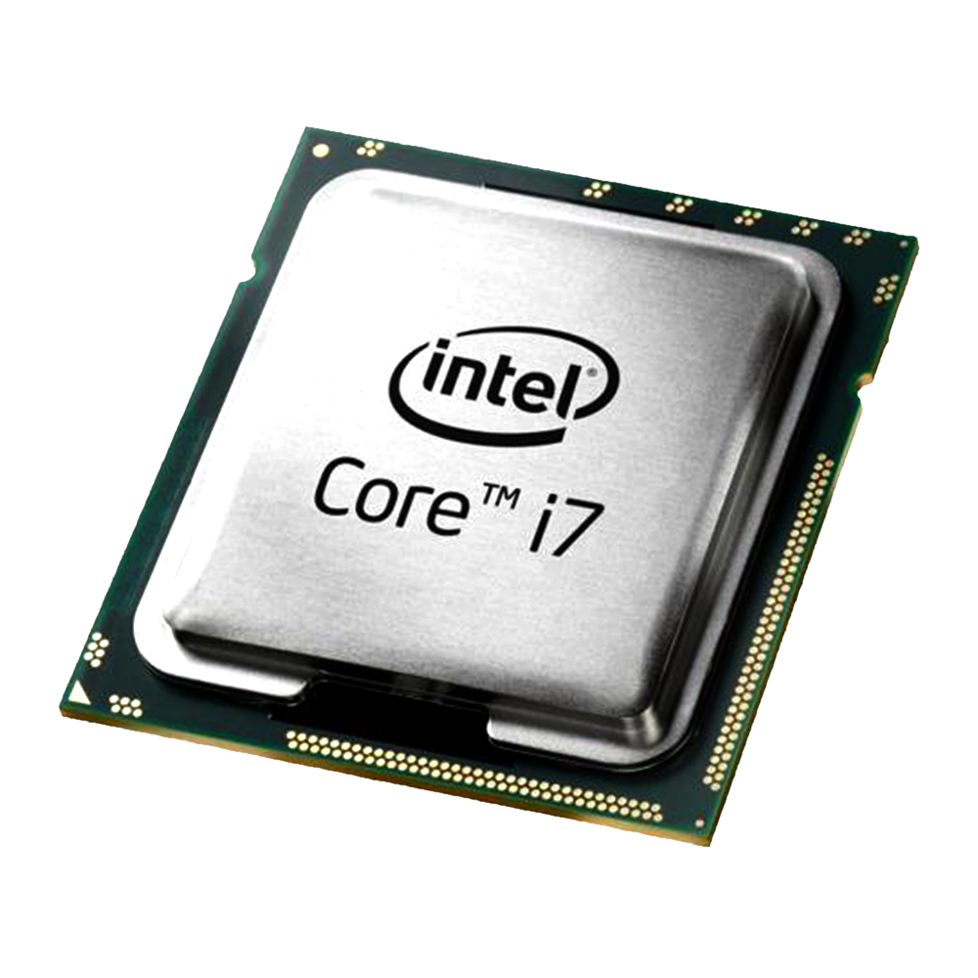
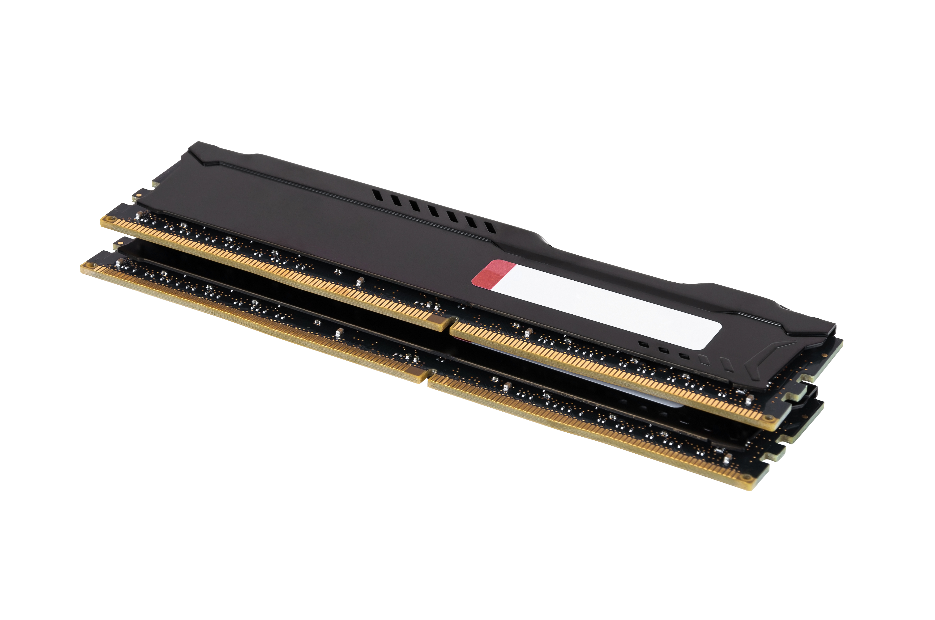
Memory Basics

Slide 67
Memory Basics
Every variable lives somewhere in memory
All the places something could live form the address space
Your Program’s Memory
OS Shared
Variables (Stack)
Variables (Heap)
Global Variables
Text (Instructions)

Slide 68
Memory Basics
Memory is usually byte-addressable, with each byte numbered from 0
1 byte = 8 bits
2^64 – 1
(on a 64-bit system)
Your Program’s Memory
OS Shared
Variables (Stack)
Variables (Heap)
Global Variables
Text (Instructions)
0x0

Slide 69
Memory Basics
The address of an object is the location of its lowest byte
For example, an integer always uses 32 bits = 4 bytes
int x = 106; // 32 bits
0x10 is the address of x
x’s memory
00000000
00000000
00000000
01101010
0x10
0x11
0x12
0x13

Slide 70
How do we get the address of a variable in C++?

Slide 71
Pointers! 👉 👉 👉

Slide 72
A pointer is the address of a variable
int* means px is a pointer to an int
& is the address of operator
int x = 106;
int* px = &x;
std::cout << x << std::endl; // 106
std::cout << *px << std::endl; // 106
std::cout << px << std::endl; // 0x50527c

Slide 73
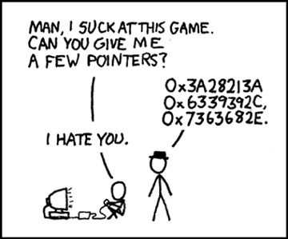

Slide 75
A pointer is just a number!
int* px
int x
0x50527c
00000000
00000000
00000000
01101010
0x50527c
0x50527d
0x50527e
0x50527f

Slide 76

int* px
int x

Slide 77
We can have pointers to all kinds of things!
int x = 106;
int* px = &x;
StanfordID id { “jtrb” };
StanfordID* p = &id;
auto name = p->name;
std::vector<int> v;
std::vector<int>* p = &v;
std::vector<int> v {
1, 2, 3, 4, 5
};
int* arr = &v[0];

Slide 78
Recall: a vector is a contiguous array
1
9
7
3
2
1
2
9
A vector is a single chunk of memory

Slide 79
Array pointer
std::vector<int> v {1,2,3,4,5};
int* arr = &v[0]; std::cout << *arr << " ";
arr += 1; std::cout << *arr << " ";
++arr; std::cout << *arr << " ";
arr += 2; std::cout << *arr << " ";
if (arr == &v[4]) std::cout << ”At last index";
0
1
2
3
4
4
5
Output:
1
2
3
1
2
3
5
At last index
arr

Slide 80
Notice anything?
std::vector<int> v {1,2,3,4,5};
int* arr = &v[0];
arr += 1;
++arr;
arr += 2;
if (arr == &v[4])
// Copy construction
// Random access
// Move pointer forward
// Random access
// Pointer comparison

Slide 81
We could do the same thing with iterators!
auto it = v.begin(); std::cout << *it << " ";
it += 1; std::cout << *it << " ";
++it; std::cout << *it << " ";
it += 2; std::cout << *it << " ";
if (it == --v.end()) std::cout << "At last element";

Slide 82
Iterators have a similar interface to pointers

Slide 83
T* is the backing type for vector<T>::iterator
template <typename T>
class vector {
using iterator = T*;
// Implementation details...
};
In the real STL implementation, the actual type is not T*.
But for all intents and purposes, you can think of it this way.

Slide 85
Recap

Slide 86
What we covered
Iterator Basics
An iterator allows us to step forward through a container
Iterator Types
Input, Output, Forward, Bidirectional, Random Access
Pointers and Memory
A pointer points to an arbitrary C++ object in memory
Pointers and iterators have the same interface

Slide 87
So how do we implement other iterators?
template <typename K, typename V>
class map {
using iterator = ???????;
// Implementation details...
};
“CS106L”
42
“Chris”
31
“Nick”
51
“Keith”
14
“Sean”
35

Slide 88
Classes We’ll learn about them next time

